Slide 1
Coding and Error Control
Chapter 5

Slide 2
Coping with Data Transmission Errors
Error detection codes
  Detects the presence of an error
Automatic repeat request (ARQ) protocols
  Block of data with error is discarded
  Transmitter retransmits that block of data
Error correction codes, or forward correction codes (FEC)
  Designed to detect and correct errors

Slide 3
Error Detection

Slide 4
Error Detection Process
Transmitter
  For a given frame, an error-detecting code (check bits) is calculated from data bits
  Check bits are appended to data bits
Receiver
  Separates incoming frame into data bits and check bits
  Calculates check bits from received data bits
  Compares calculated check bits against received check bits
  Detected error occurs if mismatch

Slide 5
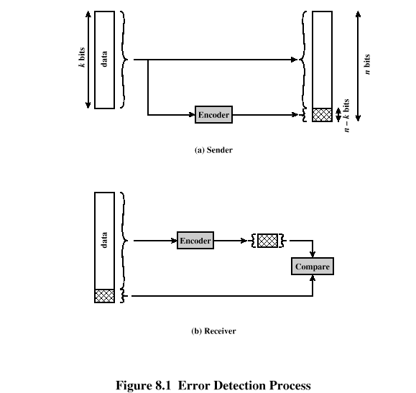
Error Detection Process

Slide 6
Parity Check
Parity bit appended to a block of data
Even parity
  Added bit ensures an even number of 1s
Odd parity
  Added bit ensures an odd number of 1s
Example, 7-bit character [1110001]
  Even parity [11100010]
  Odd parity [11100011]

Slide 7
Cyclic Redundancy Check (CRC)
Transmitter
  For a k-bit block, transmitter generates an (n-k)-bit frame check sequence (FCS)
  Resulting frame of n bits is exactly divisible by predetermined number
Receiver
  Divides incoming frame by predetermined number
  If no remainder, assumes no error

Slide 8
CRC using Modulo 2 Arithmetic
Exclusive-OR (XOR) operation
Parameters:
    T = n-bit frame to be transmitted
    D = k-bit block of data; the first k bits of T
    F = (n – k)-bit FCS; the last (n – k) bits of T
    P = pattern of n–k+1 bits; this is the predetermined divisor
    Q = Quotient
    R = Remainder

Slide 9
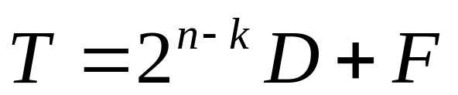
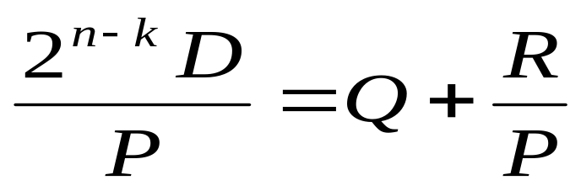
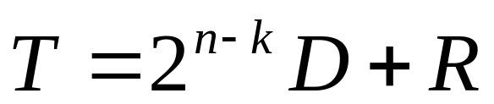
CRC using Modulo 2 Arithmetic
For T/P to have no remainder, start with
Divide 2^{n-k}D by P gives quotient and remainder
Use remainder as FCS

Slide 10
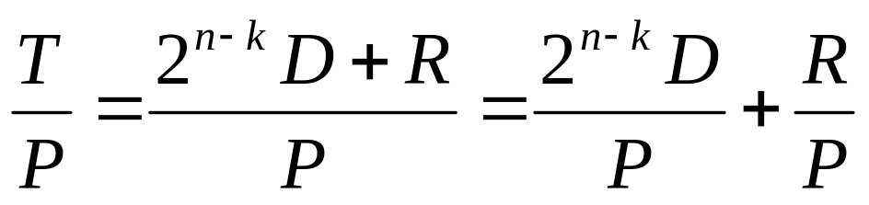
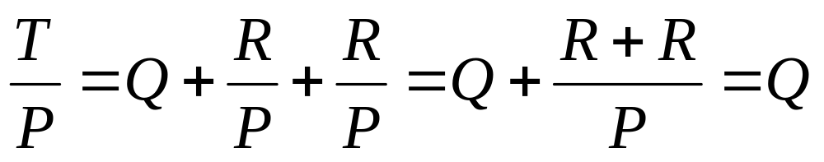
CRC using Modulo 2 Arithmetic
Does R cause T/P have no remainder?
Substituting,
  No remainder, so T is exactly divisible by P
CRC codeword is VALID (receiver assumes no error), if there is no reminder after dividing by P

Slide 11
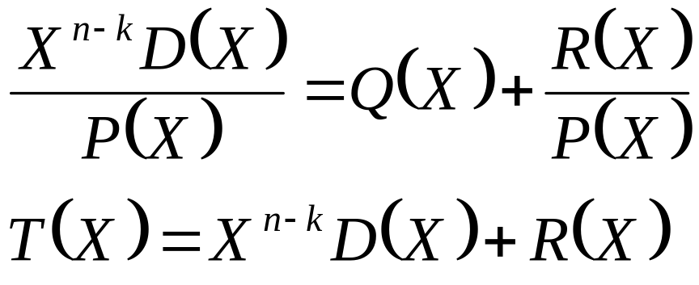
CRC using Polynomials
All values expressed as polynomials
  Dummy variable X with binary coefficients

Slide 12
CRC using Polynomials
Widely used versions of P(X)
  CRC–12
    X¹² + X¹¹ + X³ + X² + X + 1
  CRC–16
    X¹⁶ + X¹⁵ + X² + 1
  CRC – CCITT
    X¹⁶ + X¹² + X⁵ + 1
  CRC – 32
    X³² + X²⁶ + X²³ + X²² + X¹⁶ + X¹² + X¹¹ + X¹⁰ + X⁸ + X⁷ + X⁵ + X⁴ + X² + X + 1

Slide 13
CRC using Digital Logic
Dividing circuit consisting of:
  XOR gates
    Up to n – k XOR gates
    Presence of a gate corresponds to the presence of a term in the divisor polynomial P(X)
  A shift register
    String of 1-bit storage devices
    Register contains n – k bits, equal to the length of the FCS

Slide 14
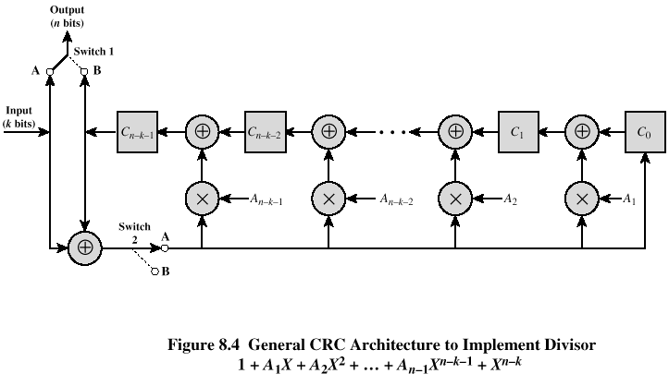
Digital Logic CRC

Slide 15
CRC using Digital Logic (cont’d)
  Example: see figure 8.3
  Given D=1010001101, P=110101
  Find the CRC: divide 2^{n-k}D by P and find the reminder.

Slide 16
Error Correction

Slide 17
Wireless Transmission Errors
Error detection requires retransmission
Detection inadequate for wireless applications
  Error rate on wireless link can be high, results in a large number of retransmissions
  Long propagation delay compared to transmission time

Slide 18
Block Error Correction Codes
Transmitter
  Forward error correction (FEC) encoder maps each k-bit block into an n-bit block codeword
  Codeword is transmitted; analog for wireless transmission
Receiver
  Incoming signal is demodulated
  Block passed through an FEC decoder

Slide 19
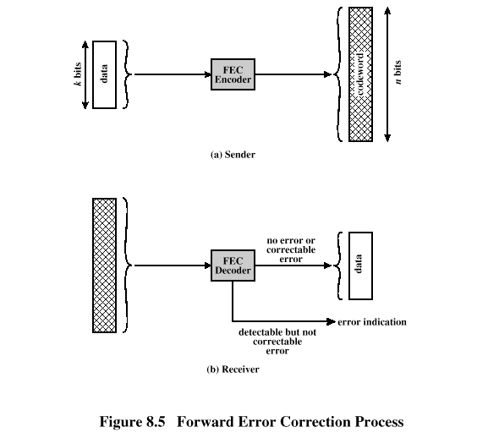
Forward Error Correction Process

Slide 20
FEC Decoder Outcomes
No errors present
  Codeword produced by decoder matches original codeword
Decoder detects and corrects bit errors
Decoder detects but cannot correct bit errors; reports uncorrectable error
Decoder detects no bit errors, though errors are present
Coding gain –the reduction in the required E_{b}/N₀ to achieve a specified BER of an error-correcting coded system (see figure 8.6)

Slide 21
Block Code Principles
Hamming distance – for 2 n-bit binary sequences, the number of different bits
  E.g., v₁=011011; v₂=110001; d(v1, v₂)=3
Redundancy – ratio of redundant bits to data bits
Code rate – ratio of data bits to total bits

Slide 22
Hamming Code
Designed to correct single bit errors
Family of (n, k) block error-correcting codes with parameters:
  Block length: n = 2^{m} – 1
  Number of data bits: k = 2^{m} – m – 1
  Number of check bits: n – k = m
  Minimum distance: d_{min} = 3
Single-error-correcting (SEC) code
  SEC double-error-detecting (SEC-DED) code

Slide 23
Hamming Code Process
Encoding: k data bits + (n -k) check bits
Decoding: compares received (n -k) bits with calculated (n -k) bits using XOR
  Resulting (n -k) bits called syndrome word
  Syndrome range is between 0 and 2^{(n-k)}-1
  Each bit of syndrome indicates a match (0) or conflict (1) in that bit position
  See Hamming_code_example

Slide 24
Cyclic Codes
Can be encoded and decoded using linear feedback shift registers (LFSRs)
For cyclic codes, a valid codeword (c₀, c₁, …, c_{n-1}), shifted right one bit, is also a valid codeword (c_{n-1}, c₀, …, c_{n-2})
Takes fixed-length input (k) and produces fixed-length check code (n-k)
  In contrast, CRC error-detecting code accepts arbitrary length input for fixed-length check code

Slide 25
BCH Codes
For positive pair of integers m and t, a (n, k) BCH code has parameters:
  Block length: n = 2^{m} – 1
  Number of check bits: n – k ≤ mt
  Minimum distance:d_{min} ≥ 2t + 1
Correct combinations of t or fewer errors
Flexibility in choice of parameters
  Block length, code rate

Slide 26
Reed-Solomon Codes
Subclass of nonbinary BCH codes
Data processed in chunks of m bits, called symbols
An (n, k) RS code has parameters:
  Symbol length: m bits per symbol
  Block length: n = 2^{m} – 1 symbols = m(2^{m} – 1) bits
  Data length: k symbols
  Size of check code: n – k = 2t symbols = m(2t) bits
  Minimum distance: d_{min} = 2t + 1 symbols

Slide 27
Convolutional Codes
Generates redundant bits continuously
Error checking and correcting carried out continuously
  (n, k, K) code
    Input processes k bits at a time
    Output produces n bits for every k input bits
    K = constraint factor
    k and n generally very small
  n-bit output of (n, k, K) code depends on:
    Current block of k input bits
    Previous K-1 blocks of k input bits

Slide 28
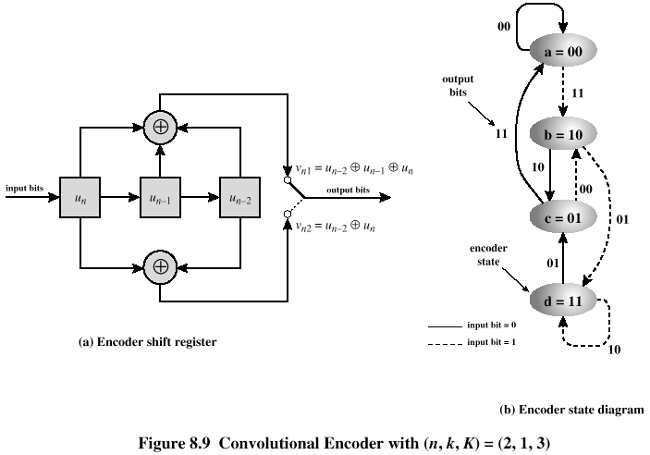
Convolutional Encoder

Slide 29
Decoding
Trellis diagram – expanded encoder diagram
Viterbi decoding algorithm
  Compares received sequence with all possible transmitted sequences
  Algorithm chooses path through trellis whose coded sequence differs from received sequence in the fewest number of places
  Once a valid path is selected as the correct path, the decoder can recover the input data bits from the output code bits

Slide 30
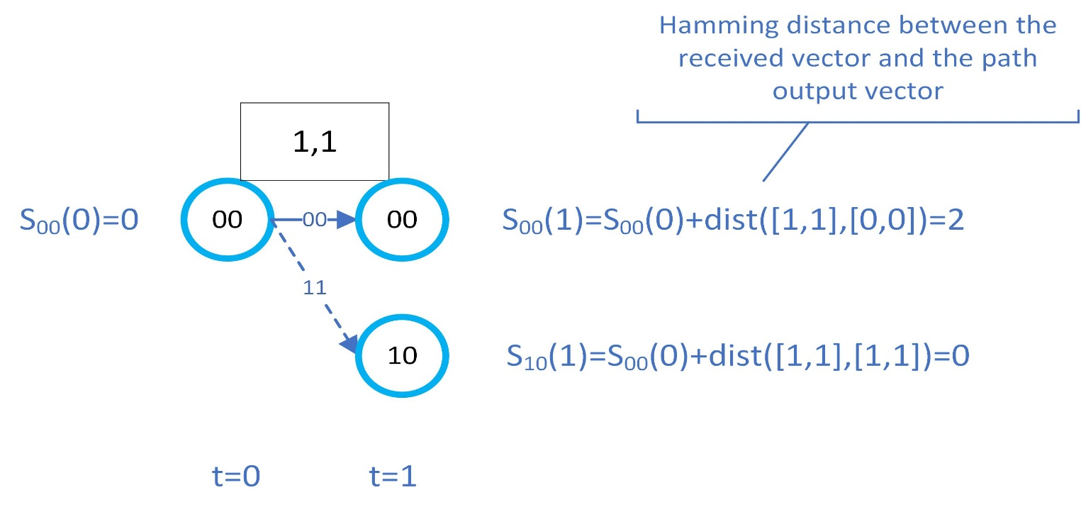
Viterbi Decoding
Viterbi decoding algorithm (see figure 8.9) , assume that the received bits are 1, 1, 1, 1, 0, 1, Find the transmitted data inputs
Let Sxx(t) be the accumulated path distance at each state xx at time t
t=1:

Slide 31
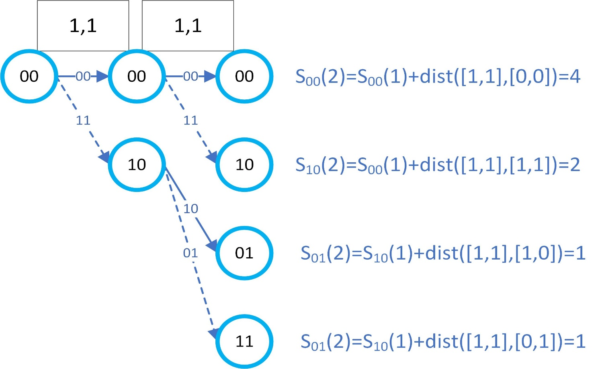
Viterbi Decoding
t=2:

Slide 32
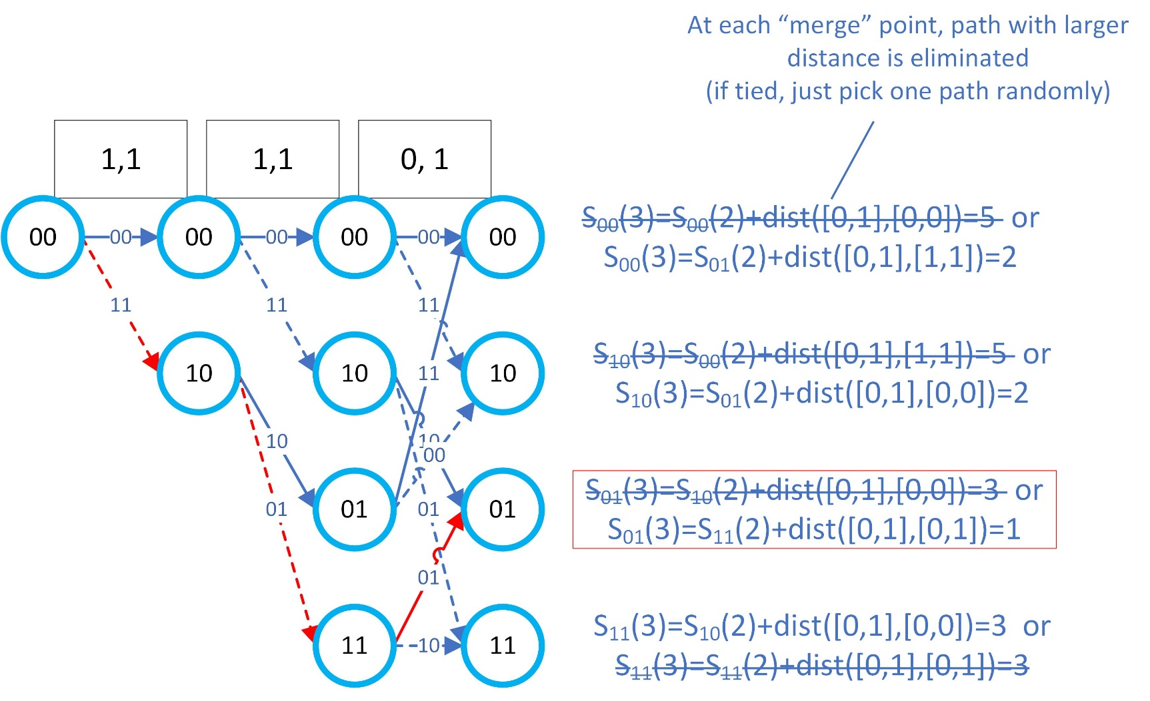
Viterbi Decoding
t=3:
The path in red is the winner path (lowest accumulated distance)! And the input data bits are therefore: 1 1 0

Slide 33
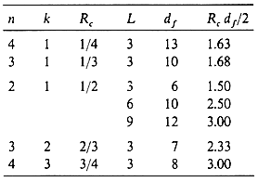
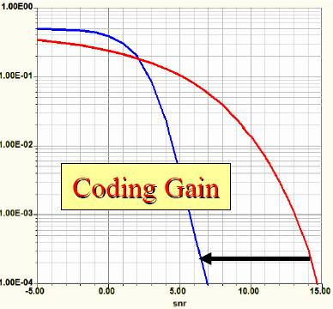
Coding gain for some selected convolutional codes
Coding gain is R_{c}d_{f} /2, where d_{f} is the free distance or minimum Euclidean distance
K is called L in this table

Slide 34
Block Interleaving
Data written to and read from memory in different orders
Data bits and corresponding check bits are interspersed with bits from other blocks
At receiver, data are deinterleaved to recover original order
A burst error that may occur is spread out over a number of blocks, making error correction possible

Slide 35
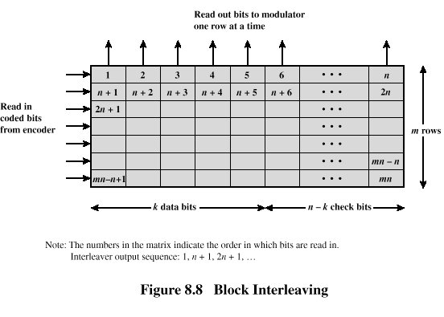
Block Interleaving

Slide 36
Modern coding schemes
A breakthrough in FEC research occurred in 1993 → the invention of turbo coding
Turbo coding
  Performance (bit error rate) is very close to the “Shannon” limit.
  Can be efficiently implemented using two parallel recursive convolutional encoders and an interleaver.
  Decoder uses iterative decoding method
LDPC (Low Density Parity Check)
  Even better performance than Turbo Code for longer codewords
  Based on iterative decoding

Slide 37
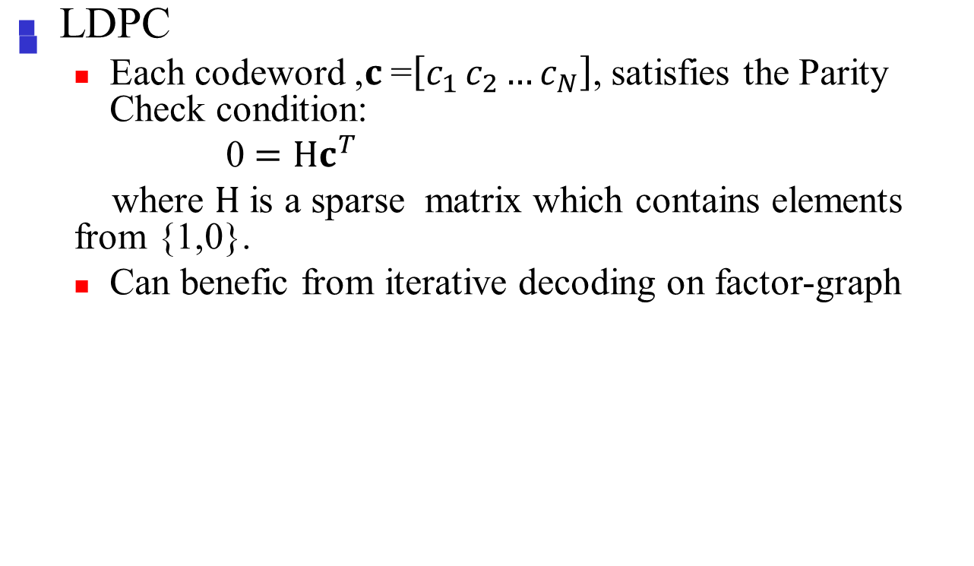
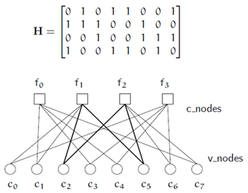
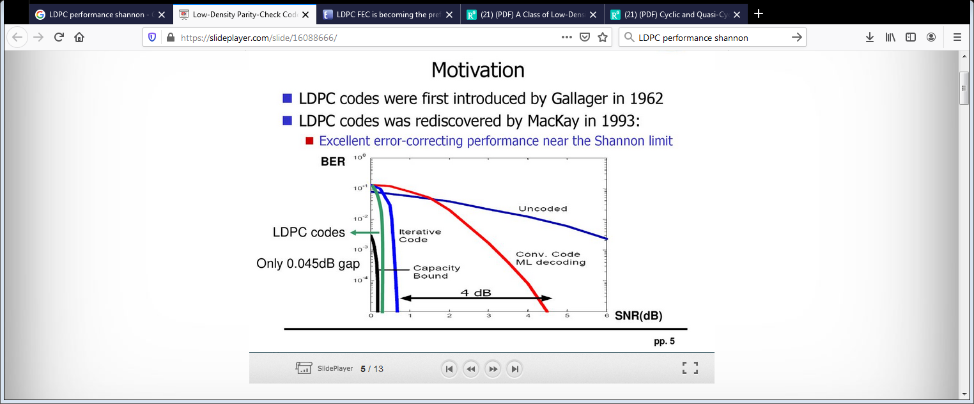
Modern coding schemes
Example: (7,4) LDPC

Slide 38
Automatic Repeat Request (ARQ)

Slide 39
Automatic Repeat Request
Mechanism used in data link control and transport protocols
Relies on use of an error detection code (such as CRC)
Flow Control
Error Control

Slide 40
Flow Control
Assures that transmitting entity does not overwhelm a receiving entity with data
Protocols with flow control mechanism allow multiple PDUs in transit at the same time
PDUs arrive in same order they’re sent
Sliding-window flow control
  Transmitter maintains list (window) of sequence numbers allowed to send
  Receiver maintains list allowed to receive

Slide 41
Flow Control
Reasons for breaking up a block of data before transmitting:
  Limited buffer size of receiver
  Retransmission of PDU due to error requires smaller amounts of data to be retransmitted
  On shared medium, larger PDUs occupy medium for extended period, causing delays at other sending stations

Slide 42
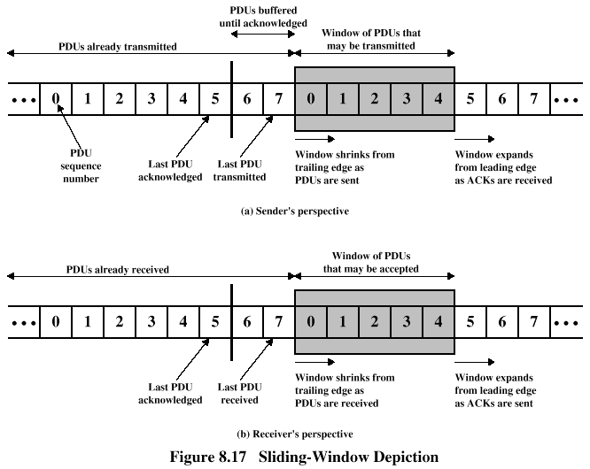
Flow Control

Slide 43
Error Control
Mechanisms to detect and correct transmission errors
Types of errors:
  Lost PDU : a PDU fails to arrive
  Damaged PDU : PDU arrives with errors

Slide 44
Error Control Requirements
Error detection
  Receiver detects errors and discards PDUs
Positive acknowledgement
  Destination returns acknowledgment of received, error-free PDUs
Retransmission after timeout
  Source retransmits unacknowledged PDU
Negative acknowledgement and retransmission
  Destination returns negative acknowledgment to PDUs in error

